Slide 1
Feed-Forward Networks and Gradient-Based Training
ECE408 / CS483 / CSE 408 Spring 2018
(Contributed by Carl Pearson)

Slide 2
Recap: Machine Learning
An important way of building applications whose logic is not fully understood.
Use labeled data – data that come with the input values and their desired output values – to learn what the logic should be
Capture each labeled data item by adjusting the program logic
Learn by example!

Slide 3
Machine Learning Tasks (1)
Classification
Which of k categories an input belongs to
Ex: object recognition
Regression
Predict a numerical value given some input
Ex: predict tomorrow’s temperature
Transcription
Unstructured data into textual form
Ex: optical character recognition

Slide 4
Machine Learning Tasks (2)
Translation
Convert a sequence of symbols in one language to a sequence of symbols in another
Structured Output
Convert an input to a vector with important relationships between elements
Ex: natural language sentence into a tree of grammatical structure
Others
Anomaly detection, synthesis, sampling, imputation, denoising, density estimation

Slide 5
Why Machine Learning Now?
GPU computing hardware and programming interfaces such as CUDA has enabled very fast research cycle of deep neural net training
Computer Vision, Speech Recognition, Document Translation, Self Driving Cars, Data Science…
Most involve logic that were previously not effectively constructed with imperative programming
Using big labeled data to train and specialize DNN based classifiers
Deriving a large quantity of quality labeled data is a challenge

Slide 6
Foundation - Logic Specification with Truth Table
a’
a
b’
b
c’
c
Input |  |  | output
a | b | c
0 | 0 | 0 | 0
0 | 0 | 1 | 1
0 | 1 | 0 | 1
0 | 1 | 1 | 0
1 | 0 | 0 | 1
1 | 0 | 1 | 0
1 | 1 | 0 | 0
1 | 1 | 1 | 1

Slide 7
What if we did not know the truth table?
Look at enough observation data to construct the rule
000 → 0
011 → 0
100 → 1
110 → 0
If we have enough observational data to cover all input patterns, we can construct the truth table and derive the logic!
Alien story.

Slide 8
What is the problem then?
The logic formulation of a 32x32-pixel (small) image recognition problem involves
1024*8 bit input,
which will have a truth table of 2⁸¹⁹⁶ entries
If we managed to collect and label 1 billion (~2³²) images as training data
We cover only 2³² / 2⁸¹⁹⁶ = 1/ 2⁸¹⁶⁴ of the truth table
Solution - learning processes that exploits features

Slide 9
Features in our logic example
Input |  |  | output
a | b | c
0 | 0 | 0 | 0
0 | 0 | 1 | 1
0 | 1 | 0 | 1
0 | 1 | 1 | 0
1 | 0 | 0 | 1
1 | 0 | 1 | 0
1 | 1 | 0 | 0
1 | 1 | 1 | 1
Feature 1: all bit patterns with odd number of 1’s result in output 1
Feature 2: all bit patters with even number of 1’s result in output 0

Slide 10
Types of Problems
Hard to formally describe
?
?
?
?
?
?
?
?
?
ECE 408 MPs
Easy to formally describe
Easy to perform
Hard to perform

Slide 11
Types of Problems
Hard to formally describe
Recognizing spoken words
Literary analysis
International diplomacy
Face detection
ECE 408 MPs
Chess
Easy to formally describe
Easy to perform
Hard to perform
Algorithm complexity, parallelism, and data bandwidth)

Slide 12
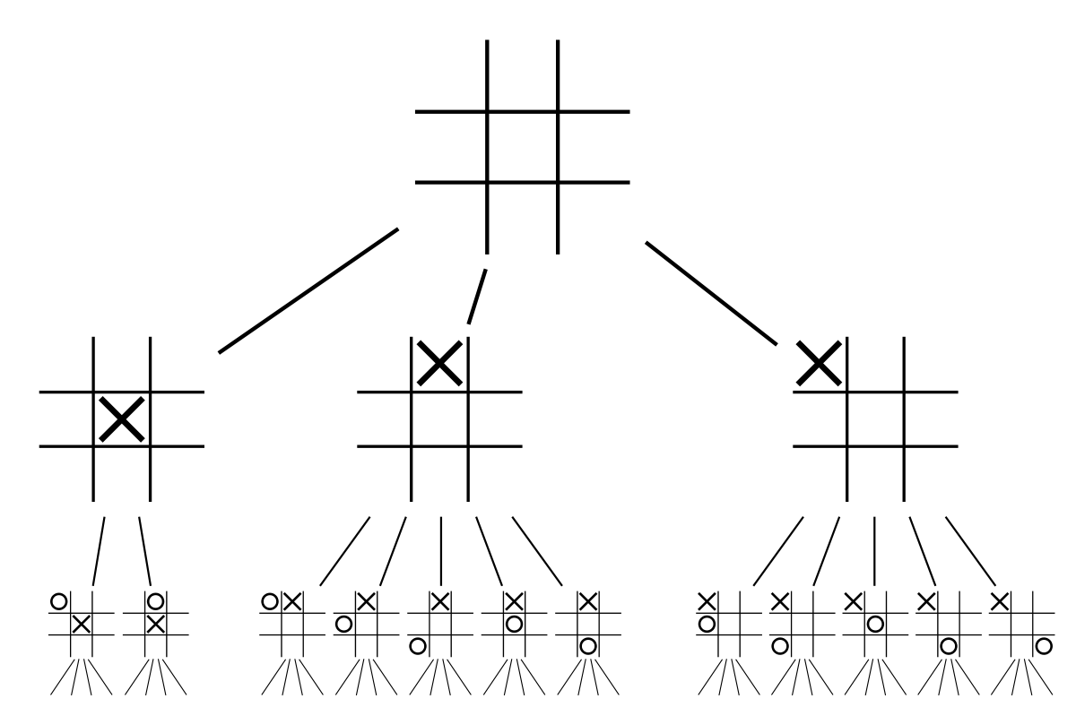
Chess as an AI Success (1)
Easy to formalize
64 locations, 32 pieces
Well-defined, allowable moves
Score each leaf in a tree of possible board positions
Proceed down path that results in best position
2-ply game tree for tic-tac-toe

Slide 13
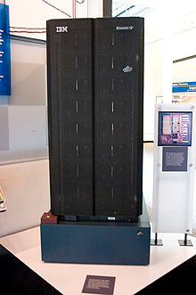
Chess as an AI Success (2)
Hard to perform
~30 legal moves per position
1,015 moves for 10-ply lookahead
30 years of compute at 1M positions/sec
Heuristics, pruning, parallel search, fast computers
Deep Blue defeated Gary Kasparov in 1997

Slide 14
Cyc: Extending Rule-based Systems to the Real World
Comprehensive ontology and knowledge base of common sense
Cyc reasons about formal statements about the world
Rules
Inference Engine
Deductions
Statements

Slide 15
Cyc: A Simple Example
(OBJ ∈ SUBSET) ∧ (SUBSET ∈ SUPERSET) ⇒ OBJ ∈ SUPERSET
Inference Engine
Donald Trump is a US President
Donald Trump is a US citizen
US Presidents are US citizens

Slide 16
Cyc: FredWhileShaving
People do not have electric parts
People have razors while shaving
Inference Engine
Razors have electric parts
Fred is shaving
Notes:
For example, Cyc failed to understand a story
about a person named Fred shaving in the morning (Linde, 1992). Its inference
engine detected an inconsistency in the story: it knew that people do not have
electrical parts, but because Fred was holding an electric razor, it believed the
entity “FredWhileShaving” contained electrical parts. It therefore asked whether
Fred was still a person while he was shaving

Slide 17
Cyc: FredWhileShaving
People do not have electric parts
People have razors while shaving
Is Fred a person while he’s shaving?
Inference Engine
Razors have electric parts
Fred is shaving
Huge amounts of statements and rules for decent results
Cannot learn new rules or statements on its own
Notes:
For example, Cyc failed to understand a story
about a person named Fred shaving in the morning (Linde, 1992). Its inference
engine detected an inconsistency in the story: it knew that people do not have
electrical parts, but because Fred was holding an electric razor, it believed the
entity “FredWhileShaving” contained electrical parts. It therefore asked whether
Fred was still a person while he was shaving

Slide 18
Types of Problems
Hard to formally describe
Recognizing spoken words
Literary analysis
?????
International diplomacy
Face detection
Machine Learning!
ECE 408 MPs
Chess
Easy to formally describe
Easy to perform
Hard to perform

Slide 19
The “Machine Learning” Approach
Challenge
Hard to formalize the problem.
Solution
Don’t formalize the problem.
Let the machine learn from experience.

Slide 20
Classic Machine Learning
Output
Humans choose features
Learn how features are associated with outputs
Output
Mapping from Features
Hand-Designed Program
Hand-Designed Features
Input
Input
Rule-based Systems
Classic Machine Learning

Slide 21
You may have heard of…
Naïve Bayes
Features as independent contributors to output
Logistic Regression
Learn how to weight each feature’s contribution to output, usually through gradient descent*
*more on this in a later lecture
Notes:
Ranking the Risk Factors for Cesarean: Logistic Regression Analysis of a Nationwide Study

Slide 22
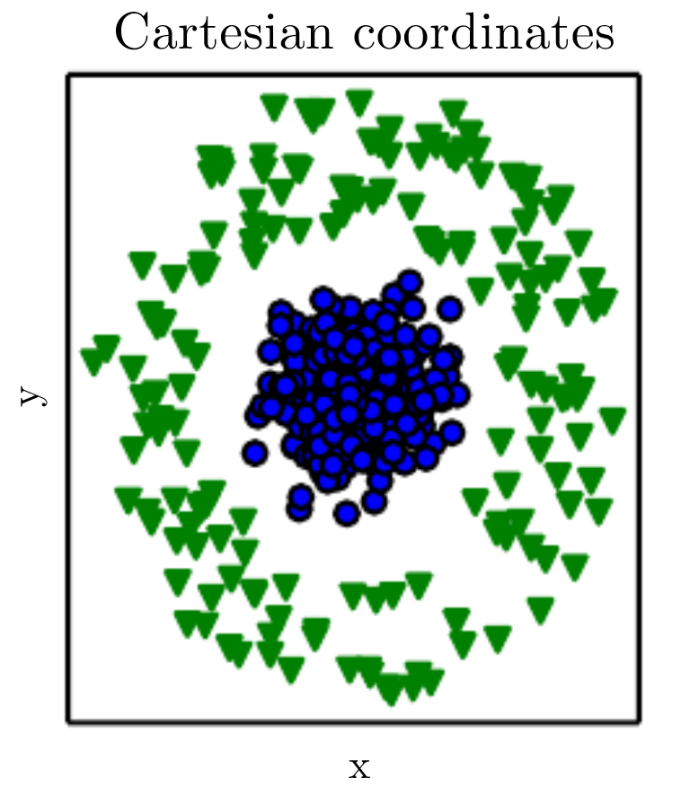
Data Representation is important!

Slide 23
y - 2x < 10

Slide 24
y - 2x < 10
y + 3x < 15

Slide 25
y - 2x < 10
10y + x < 50
y + 3x < 15

Slide 26
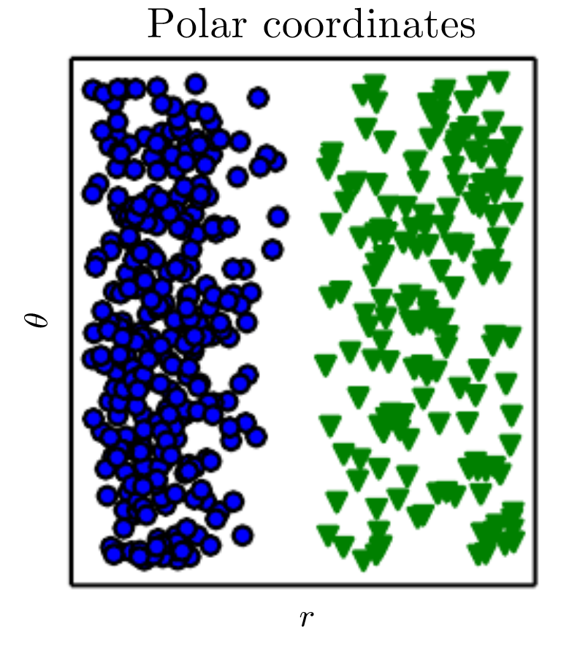
Θ = arctan( y / x )
r = sqrt( x² + y² )

Slide 27








Different Features for Different Tasks
Image
Vision Features
Detection
Audio
Audio Features
Identify Speaker
Text classification, machine translation, information retrieval
Text Features
Text

Slide 28
Which Data Features are Relevant
Detecting a car in an image
Cars have wheels ➡ presence of a wheel?
Can we describe pixel values that make up a wheel?
Circle-shaped?
Dark around perimeter?

Slide 29
Which Data Features are Relevant
Detecting a car in an image
Cars have wheels ➡ presence of a wheel?
Can we describe pixel values that make up a wheel?
Circle-shaped?
Dark around perimeter?
But what about?
Occlusion, perspective, shadows, white-walled tires, …

Slide 30
Identify Factors of Variation that Explain Data
Unobserved objects or forces that affect observed quantities
Mental constructs that provide simplifying explanations or inferred causes
Ex: speech
Age, sex, accent, words being spoken
Ex: car
Position, color, angle of sun
Many factors influence each piece of observed data

Slide 31
Representation Learning Approach
Challenge
Which data features are relevant?
Solution
Learn the features too!
(Looking ahead)
Deep Learning: a deep hierarchy of features

Slide 32
Machine Learning
Ability to acquire knowledge by extracting patterns from data

Slide 33
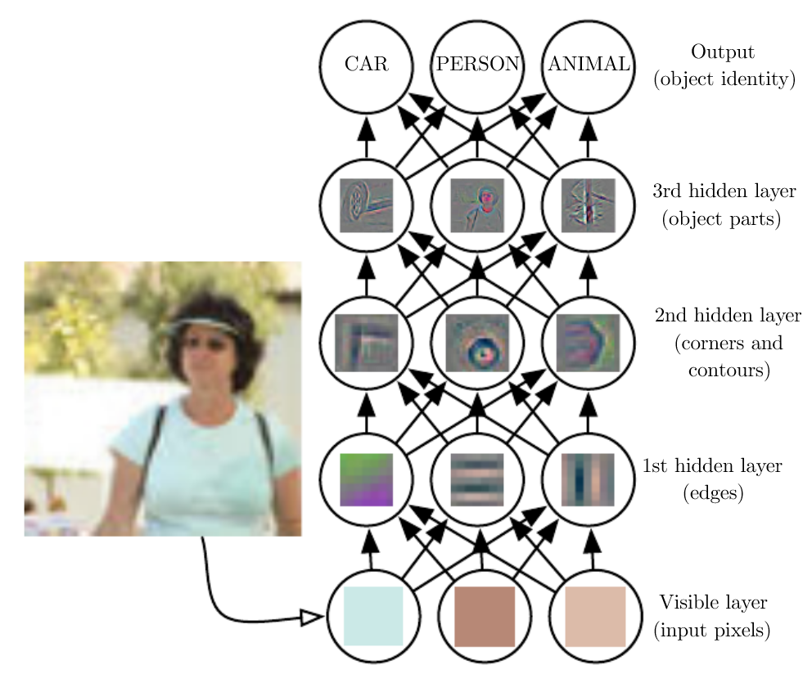
Deep Learning
A type of representation learning
Representations expressed in terms of other representations

Slide 34
Deep Learning Approach
Challenge
Hard to formalize the problem?
Which data features are relevant?
Solution
Don’t formalize the problem
Let the machine learn from experience
Hierarchy of concepts to capture simple and complicated features
Learn the hierarchy too!

Slide 35
Summary
Output
Output
Mapping from Features
Output
Mapping from Features
Layers of Abstract Features
Hand-Designed Program
Hand-Designed Features
Simple Features
Input
Input
Input
Rule-based Systems
Classic Machine Learning
Deep Learning

Slide 36
Classification
Formally: a function that maps an input to k categories
f : R^{n} → {1, …, k},
Our formulation: a function f parameterized by ϴ that maps input vector x to numeric code y
y = f(x, ϴ)
ϴ encapsulates the structure and weights in our network

Slide 37
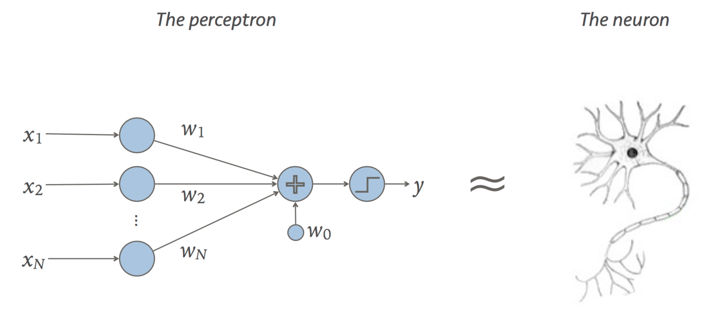

Linear Classifier (Perceptron)
Recall our formulation:
Dot product:
Scalar addition:
y = f(x, ϴ)
y = sign(W • x + b)
ϴ = {W, b}
output
y = W • x
input
+ b
weight
bias

Slide 38
Multi-Layer Perceptron
What if a linear classifier can’t learn a function?
XOR
AND
OR
?
=
+

Slide 39
Multi-Layer Perceptron
XOR
AND
OR
?
=
+
x[0] + x[1] – 1.5 > 0
x[0] + x[1] – 0.5 > 0
x[1] | x[0] | AND | OR | XOR
0 | 0 | 0 (-1.5 < 0) | 0 (-0.5 < 0) | 0 (-2.0 < 0)
0 | 1 | 0 (-0.5 < 0) | 1 ( 0.5 > 0) | ? ( 0 ? 0)
1 | 0 | 0 (-0.5 < 0) | 1 ( 0.5 > 0) | ? ( 0 ? 0)
1 | 1 | 1 ( 0.5 > 0) | 1 ( 1.5 > 0) | 1 (2.0 > 0)
XOR is not a linear combination of AND and OR functions.

Slide 40
x[1] | x[0] | AND | OR | XOR
0 | 0 | -1 | -1 | -1 (-3 < 0)
0 | 1 | -1 | +1 | 1 (1 > 0)
1 | 0 | -1 | +1 | 1 (1 > 0)
1 | 1 | +1 | +1 | -1 (-1 < 0)
OR = sign(x[0] + x[1] - 0.5)
sign() function adds non-linearity to “reposition” data points for the next layer.
AND = sign(x[0] + x[1] - 1.5)
OR Perceptron
2
x[0]
×
+
×
x[1]
1
×
-0.5
y
+
x[0]
×
+
×
-2
x[1]
1
×
-1
-1.5
1
AND Perceptron
XOR = sign(2 * OR - AND - 2)

Slide 41
Multi-Layer Perceptron – data repositioning
OR
XOR
AND
XOR = sign(2 * OR - AND - 2)
x[1] | x[0] | AND | OR | XOR
0 | 0 | -1 | -1 | -1 (-3 < 0)
0 | 1 | -1 | +1 | 1 (1 > 0)
1 | 0 | -1 | +1 | 1 (1 > 0)
1 | 1 | +1 | +1 | -1 (-1 < 0)
XOR is not a linear combination of AND and OR functions.

Slide 42
Generalize to Fully-Connected Layer
y[0]
y[1]
y[2]
y[3]
y[4]
x[0]
x[1]
x[2]
x[0]
x[1]
x[2]
y
Linear Classifier:
Input vector x×weight vector w to produce scalar output y
Fully-connected:
Input vector x×weight matrix w to produce vector output y

Slide 43
Multilayer Terminology
Weight matrices: Entry i,j is weight between i^{th} input and j^{th} output
x[0] x[1] x[2] x[3]
Input Layer
W₁[i, j] is [4x4]
b₁[j] is [4x1]
Hidden Layer(s)
W₂[i, j] is [4x3]
b₂[j] is [3x1]
“nodes”
Output Layer
k[0] k[1] k[2]
Probability that input is class k[i]
Argmax
y

Slide 44
How to determine the weights?
Fully connected layer with 784 inputs, 1024 outputs:
[784 x 1024] weight matrix
[1024 x 1] bias vector
Look at observational data to determine the weights.
With enough input data and corresponding desired outputs, we can model the relationship between inputs and outputs.

Slide 45
Forward and Backward Propagation
Forward (inference)
Given parameters ϴ and input x, produce label y
Backward (training)
Given input data and target label t, determine ϴ

Slide 46
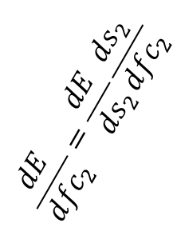
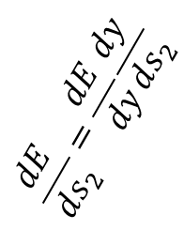
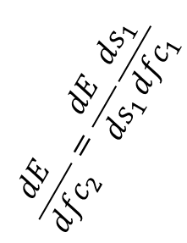
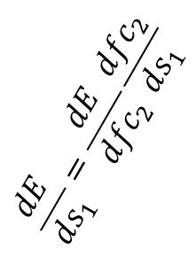
Forward and Backward Propagation
s₁ = sigmoid(fc₁)
s₂ = sigmoid(fc₂)
Forward:
fc₁ = W₁ • x + b₁
fc₂ = W₂ • s₁ + b₂
y = argmax(s₂)
x
dE/dy
Backward:
$$\frac{dE}{d{fc}_{2}}=\frac{dE}{ds_{1}}\frac{ds_{1}}{d{fc}_{1}}$$
$$\frac{dE}{ds_{1}}=\frac{dE}{d{fc}_{2}}\frac{d{fc}_{2}}{ds_{1}}$$
$$\frac{dE}{d{fc}_{2}}=\frac{dE}{ds_{2}}\frac{ds_{2}}{d{fc}_{2}}$$
$$\frac{dE}{ds_{2}}=\frac{dE}{dy}\frac{dy}{ds_{2}}$$

Slide 47
Ingredients for Gradient-Based Supervised Training
One labeled dataset (large)
Example: 60,000 28x28 grayscale images of handwritten numbers, each labeled
One network architecture
Example: perceptron
y = W • x + b
One error function
For target label t, network output y,
Example: E = ½ (y – t)²
Recall: ϴ = {W, b}

Slide 48
Stochastic Gradient Descent
For each labeled image:
Read data to initialize input layer
Evaluate network to get y (forward)
Compare with target label t to get error E
Backpropagate error derivative to get parameter updates
Adjust parameters ϴ in a direction that reduces total E over entire training set.
ϴ_{i+1} = ϴ_{i} - εΔϴ
Each gradient update happens from most accurate minima estimation

Slide 49
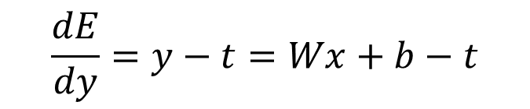
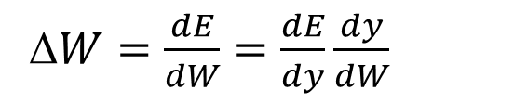

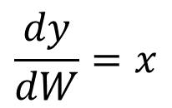
Computing the Gradient Update
ϴ_{i+1} = ϴ_{i} - εΔϴ
W_{i+1} = W_{i} - εΔW
Parameter Update
y = W • x + b
Network function
$$\frac{dy}{dW}=x$$
Network weight gradient
E = ½ (y – t)²
Error function
$$\frac{dE}{dy}=y−t=Wx+b−t$$
Error function gradient
Δ$W=\frac{dE}{dW}=\frac{dE}{dy}\frac{dy}{dW}$
Gradient weight update expression
$$\text{W}\text{i}\text{+1 = }\text{W}\text{i}\text{ – }\text{ε}\text{(}\text{W}\text{x}\text{+}\text{b}\text{−}\text{t}\text{)}\text{x}$$
Full weight update term

Slide 50
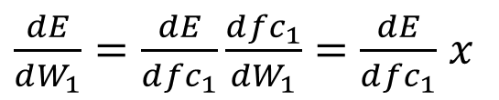
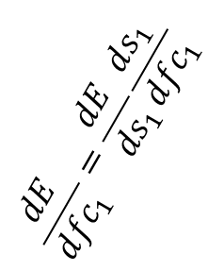
Parameter Updates and Propagation
fc₁ = W₁ • x + b₁
dE/dy
$$\frac{dE}{d{fc}_{1}}=\frac{dE}{ds_{1}}\frac{ds_{1}}{d{fc}_{1}}$$
$$\frac{dE}{ds_{1}}=\frac{dE}{d{fc}_{2}}\frac{d{fc}_{2}}{ds_{1}}$$
$$\frac{dE}{d{fc}_{2}}=\frac{dE}{ds_{2}}\frac{ds_{2}}{d{fc}_{2}}$$
$$\frac{dE}{ds_{2}}=\frac{dE}{dy}\frac{dy}{ds_{2}}$$
Need propagated error gradient (from backward pass)
Weight update
$\frac{dE}{dW_{1}}=\frac{dE}{d{fc}_{1}}\frac{d{fc}_{1}}{dW_{1}}=$ $\frac{dE}{d{fc}_{1}}$ $x$
Need input (from forward pass)

Slide 51
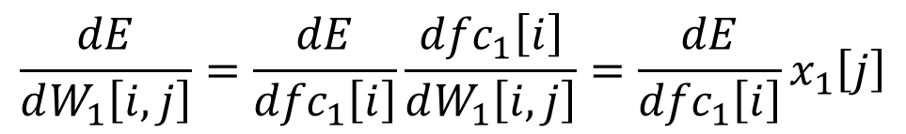
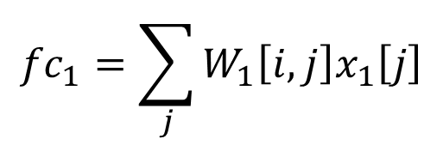
Fully-Connected Gradient Detail
i^{th} entry in fc₁
i^{th} row in W₁
j^{th} entry in x₁
fc₁[0]
fc₁[1]
fc₁[2]
…
W₁[0,:] W₁[1,:] W₁[2,:]
…
x₁[0]
x₁[1]
x₁[2]
x₁[3]
…
=
$${fc}_{1}=\sum_{j}{W_{1}\left[i,j\right]x_{1}\left[j\right]}$$
Computed from previous layer
$$\frac{dE}{dW_{1}\left[i,j\right]}=\frac{dE}{{dfc}_{1}\left[i\right]}\frac{{dfc}_{1}\left[i\right]}{dW_{1}\left[i,j\right]}=\frac{dE}{{dfc}_{1}\left[i\right]}x_{1}\left[j\right]$$
Need input to this layer

Slide 52
Batched Stochastic Gradient Descent
A training epoch (a pass through whole training set)
Set Δϴ = 0
For each labeled image:
Read data to initialize input layer
Evaluate network to get y (forward)
Compare with target label t to get error E
Backpropagate error derivative to get parameter updates
Accumulate parameter updates into Δϴ
ϴ_{i+1} = ϴ_{i} - εΔϴ
Aggregate gradient update most accurately reflects true gradient

Slide 53
Mini-batch Stochastic Gradient
For each batch in training set
For each labeled image in batch:
Read data to initialize input layer
Evaluate network to get y (forward)
Compare with target label t to get error E
Backpropagate error derivative to get parameter updates
Accumulate parameter updates into Δϴ
ϴ_{i+1} = ϴ_{i} - εΔϴ
Balance between accuracy of gradient estimation and parallelism

Slide 54
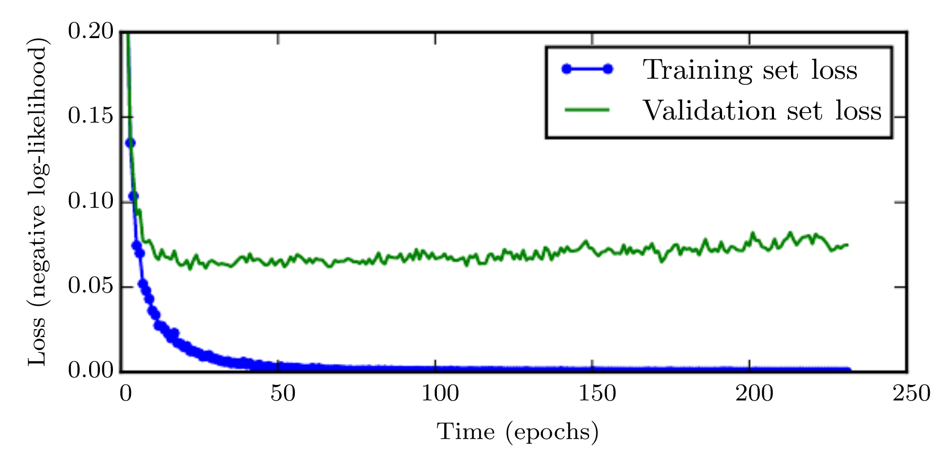
When is training done?
Split labeled data into training and test sets.
Training data to compute parameter updates.
Test data to check how model generalizes to new inputs (the ultimate goal!)
The network can become too good at classifying training inputs!

Slide 55
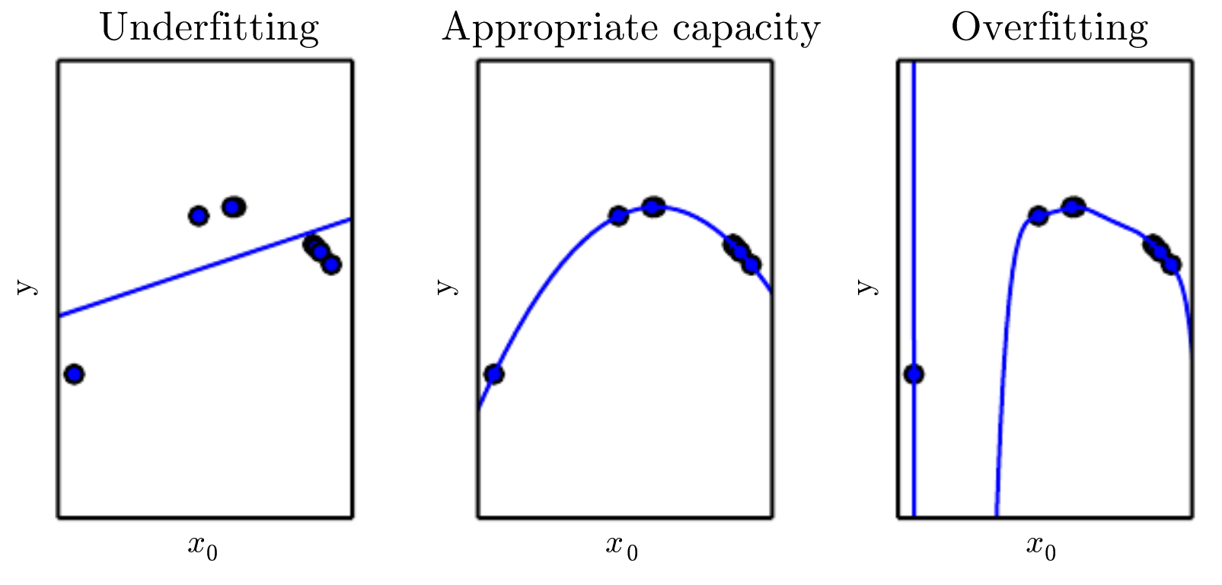
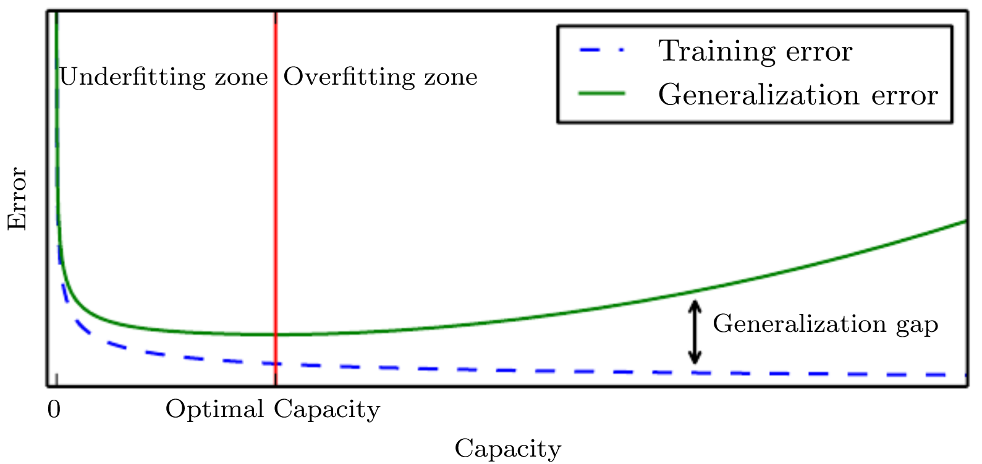
How Complicated Should a Network Be?
Intuition: like a polynomial fit. More higher-order terms make a better fit, but add huge unpredictable swings as input changes
If network is too good at training data, new inputs cause big unpredictable output changes.

Slide 56
No Free Lunch Theorem
Every classification algorithm has the same error rate when classifying previously unobserved inputs when averaged over all possible input-generating distributions.
Even neural networks must be tuned for specific tasks

Slide 57
Summary (1)
Classification:
f : R^{n} → {1, …, k},
y = f(x, ϴ)
Current ML work driven by cheap compute, lots of available data
Perceptron as a trivial deep network
y = sign(W • x + b)
Forward for inference, backward for training

Slide 58
Summary (2)
Chain rule to compute parameter updates
Stochastic gradient descent for training

